Slide 1
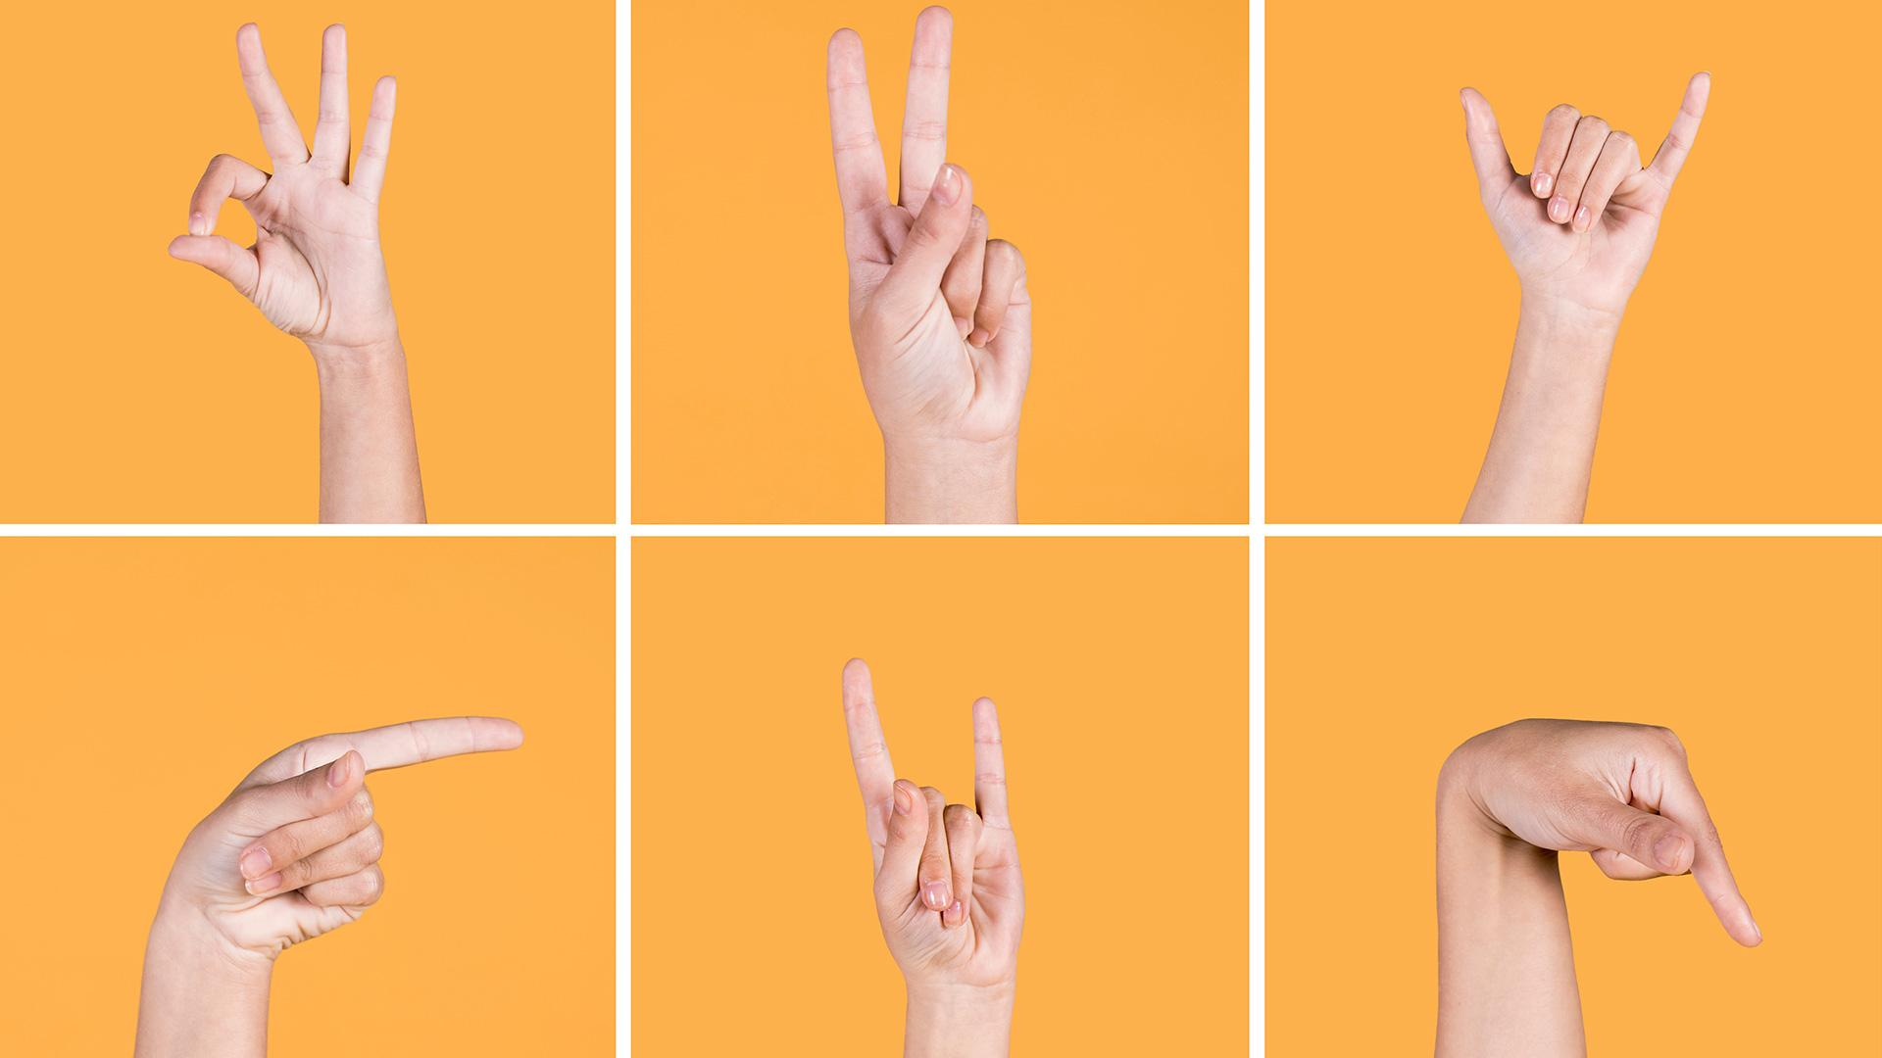
SIGN LANGUAGE RECOGNITION USING DEEP LEARNING
BY
EESALA TEJASRI
2020BCS-029
Under the Supervision of
Prof.Aditya Trivedi

Slide 2
CONTENTS OF THE PRESENTATION
INTRODUCTION
MOTIVATION
OBJECTIVES
PROBLEM STATEMENT
METHODOLOGY
PROPOSED HYPOTHESIS
DATA COLLECTION
PRE-PROCESSING
MODEL AND TOOLS
EVALUATION AND DEMO
FUTURE SCOPE AND LIMITATIONS
CONCLUSION

Slide 3
INTRODUCTION
When it comes to sharing or expressing knowledge or emotions, or when bringing individuals closer together for better understanding, communication is crucial.
It is more difficult for those with disabilities, such as the deaf and dumb, to communicate using natural language.
In order to communicate with one another and with the rest of the world, they use sign language.

Slide 4
MOTIVATION
Even though deaf and dumb can learn sign language, it would be difficult for normal people to understand the actual meaning behind the signs.
This may lead to a communication gap between normal people and specially-abled communities.
A system that comprehends signs and gestures and communicates information to non-hearing individuals is required since hearing-impaired individuals have difficulty communicating via words.

Slide 5
OBJECTIVES
According to the survey conducted by the United Nations on the occasion of International Sign Languages Day, Over 70 million individuals use sign language as their primary form of communication worldwide, with 10 million of those being in India.
To make sign language a building a bridge of social interaction and communication between higher functioning persons and people with disabilities, a Sign language recognition project has been built.

Slide 6
METHODOLOGY
DATA PRE-PROCESSING
DATA COLLECTION
TRAINING AND TESTING
EVALUATION
Thresholding is a method of segmenting where we make the image easier to analyze. In this method, we convert to color or grayscale images into binary format.
In this project we create our own dataset using OpenCV, which allows access to the webcam and captures the hand signs.
We use Convolutional Neural Networks(CNN) model to train the data. A CNN is a preferred architecture because the project calls for picture categorization.
After the model has been trained, we'll test it to see how accurate it will be on a fresh dataset, or test dataset, using an evaluation technique that yields loss value & accuracy.

Slide 7
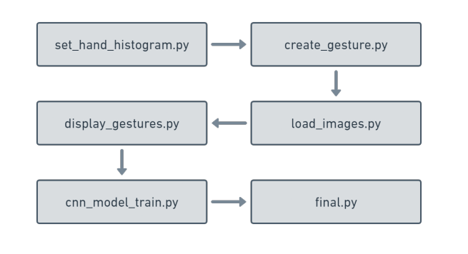
WORK FLOW OF APPLICATION

Slide 8
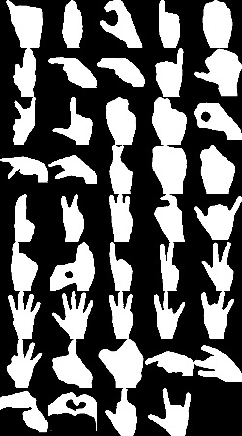
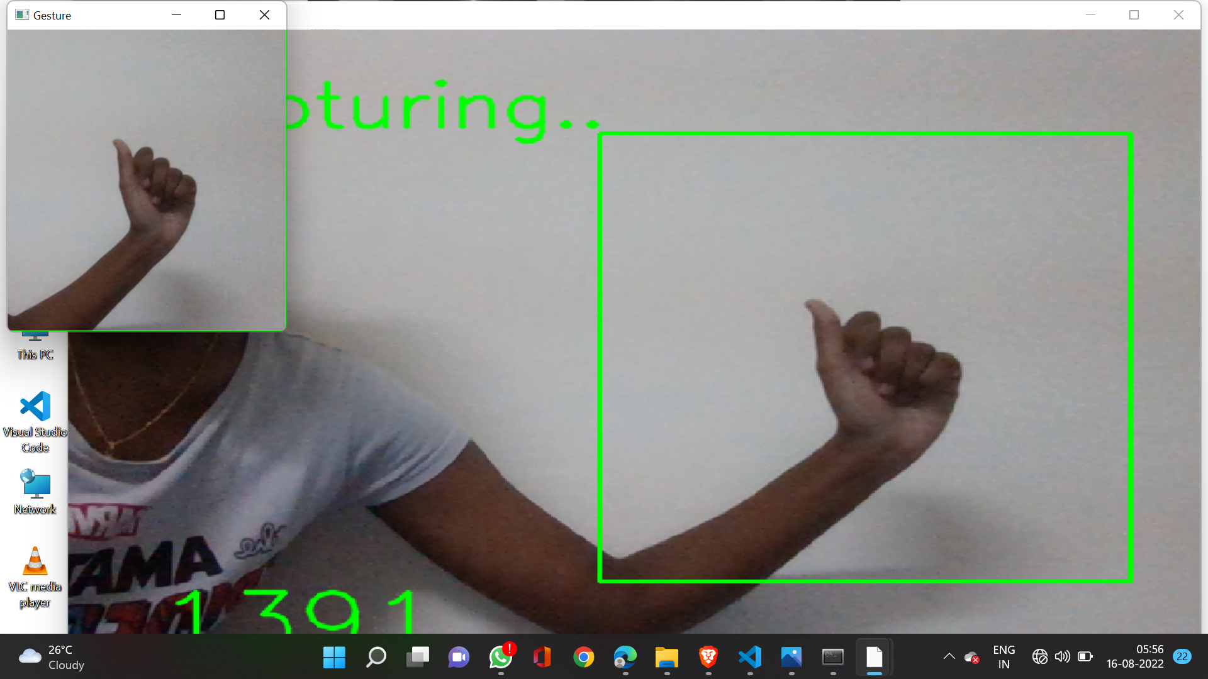
DATA COLLECTION
Using OpenCV, we generate a custom dataset.
There are 44 total classes, each with 2400 images.
These images were then preprocessed.

Slide 9
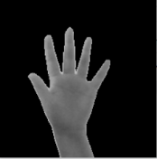
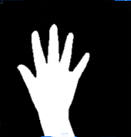
DATA PRE-PROCESSING
Instead of segmenting the hand out of a random background in order to produce better accuracy for our large number of symbols, we keep the background of the hand a constant single color so that we are not forced to segment it according to skin tone.
The representation of an image as a 3D matrix with dimensions for the image’s height and width and channel. Additionally, these pixel values are employed in CNN to extract useful features.

Slide 10
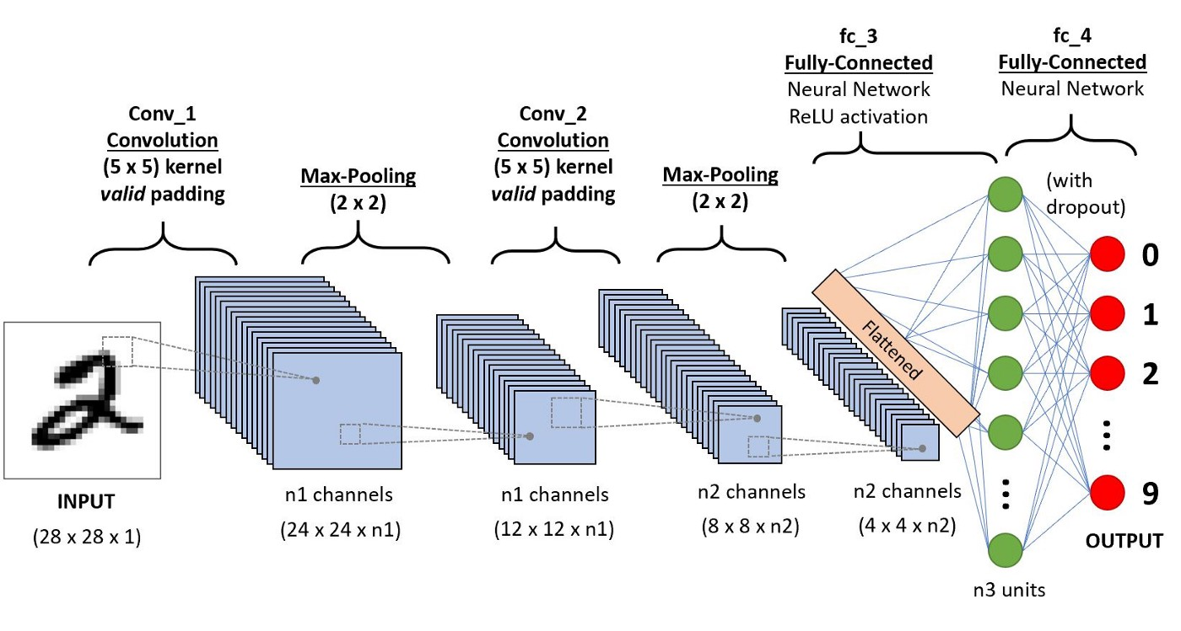
MODEL AND TOOLS USED
The model used for the project was Convolutional Neural Networks(CNN).
ReLU and softmax are the activation functions used in this project.

Slide 11
MODELS AND TOOLS USED
MODELS USED
Model Accuracy:0.99954
Model Loss: 0.00121
• SVM: 91.226%
• Random Forest: 95.719%
• KNN: 87.542
TOOLS USED
OpenCV
Tensorflow
Keras
pyttsx3

Slide 12
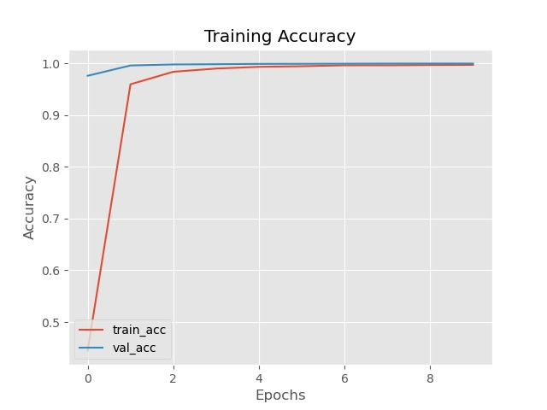
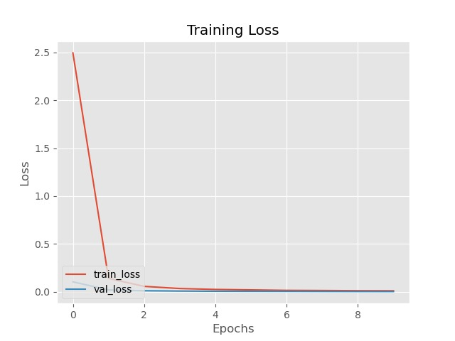
EVALUATION

Slide 13
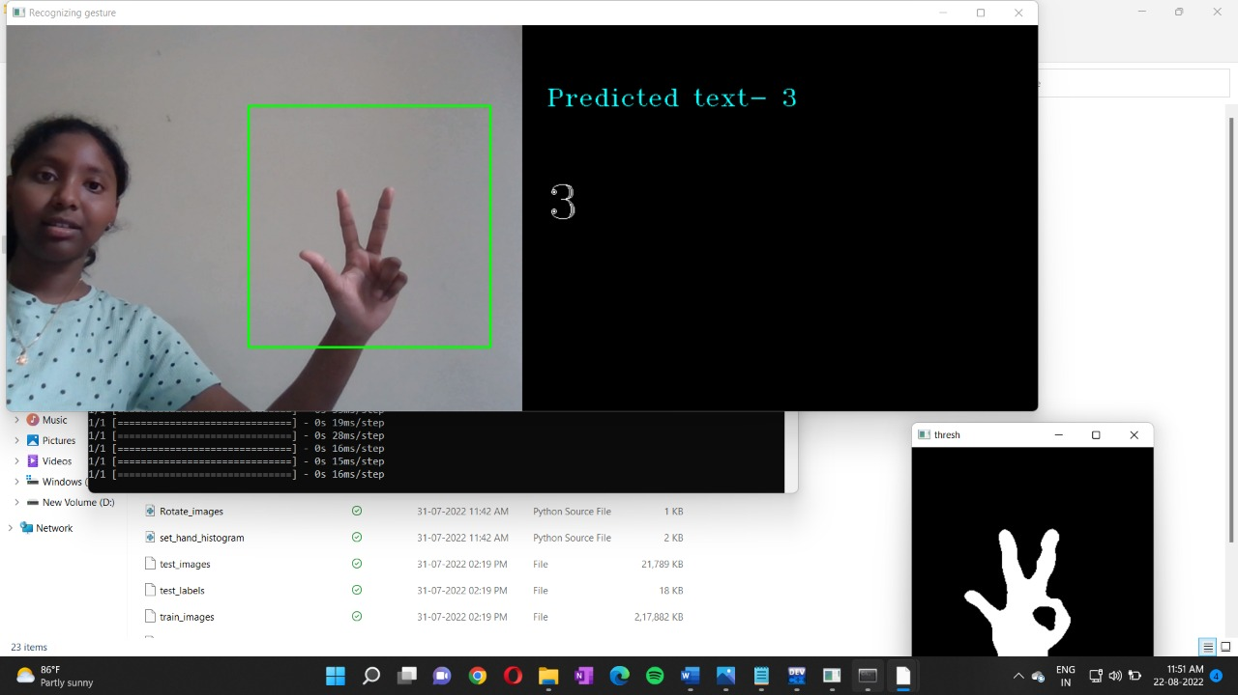
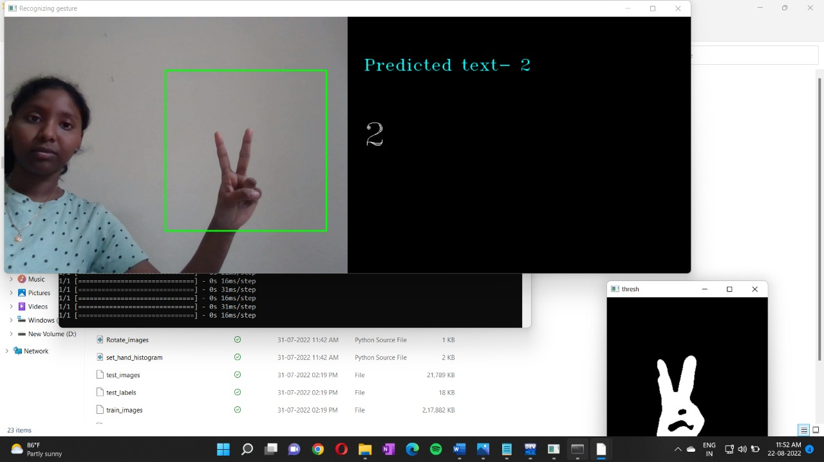
DEMO OF THE PROJECT

Slide 14
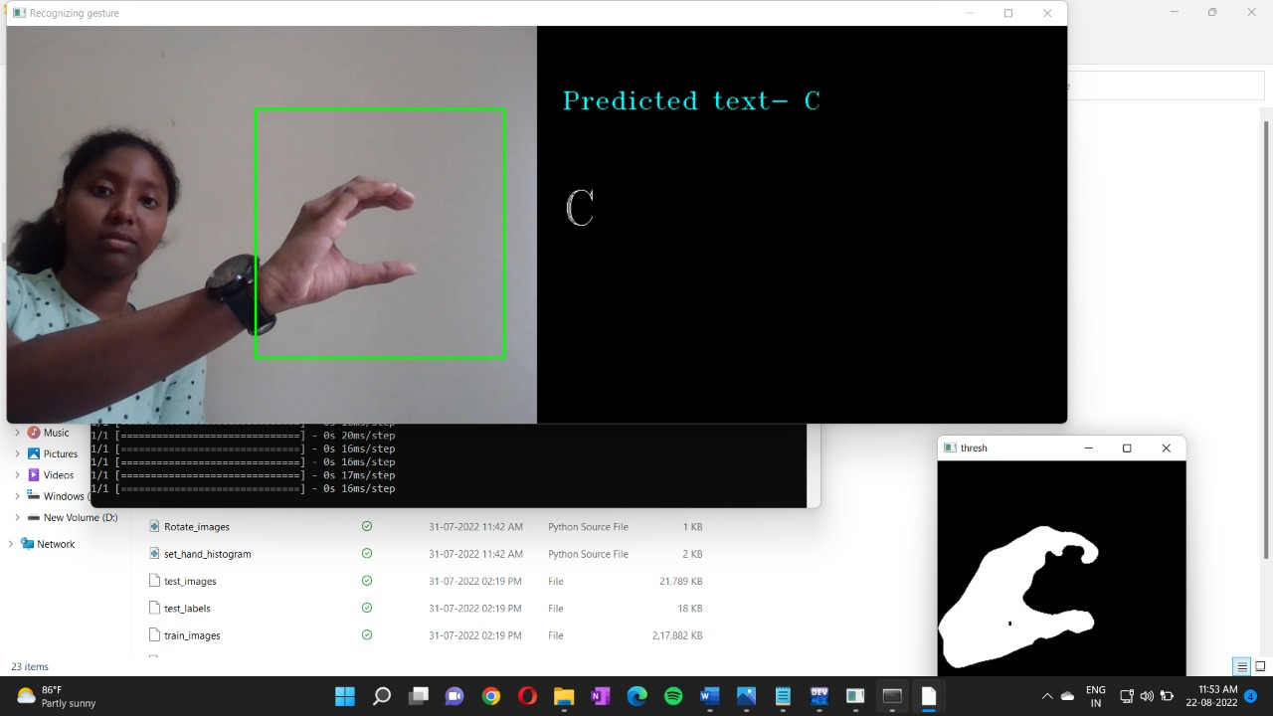
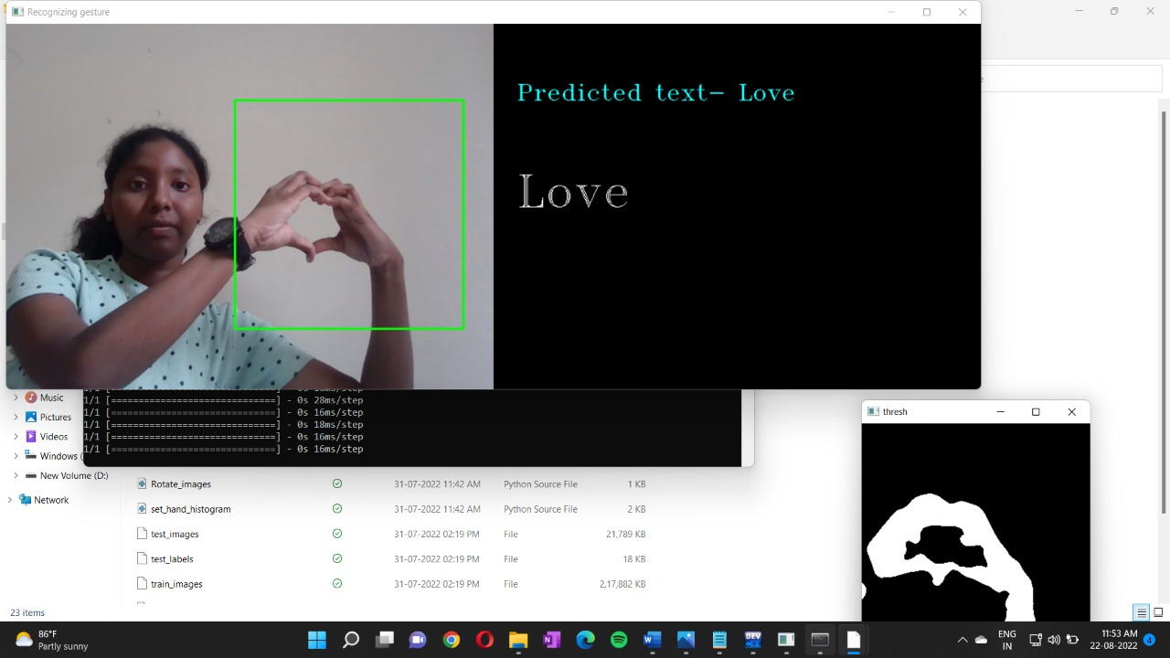
DEMO OF THE PROJECT

Slide 15
LIMITATIONS
The built system may take time to predict the sign if the background is noisy.
The built system won’t be able to detect other countries’ languages and sentences.
Low light intensity and uncontrolled background which causes a decrease in the accuracy of the detection.

Slide 16
FUTURE SCOPE
Although considerable work has to be done in this area, the suggested method is a strong starting point for the creation of any vision-based sign language recognition user interface system. The system can be set up to learn the new language gestures and the sign language syntax can be readily altered.
Future work should improve the Image Processing portion to enable bidirectional interaction, i.e., the ability to translate between sign language and standard English.
Future studies can build on this work to detect continuous sign language gestures more precisely. so that we can detect sign language sentences.
It can also be made available for smartphones in the future using a sensor-based approach.

Slide 17
CONCLUSION
In this project, we proposed an idea for feasible communication between the hearing impaired and normal people with the help of deep learning approaches.
The above work shows that it can be solved with better accuracy when we actually consider the segmented RGB hand gestures.
Future work is intended to keep improving the system and make experiments with complete language datasets.

Slide 18
THANK YOU

